Slide 1

Retinal Fundus Image Segmentation
Presented by – Varshith gundla

Slide 2
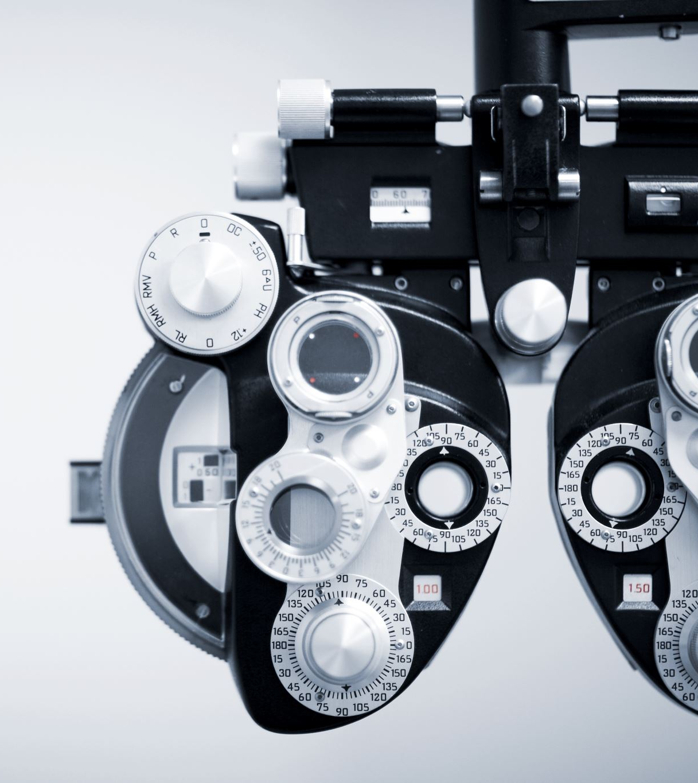
Introduction
Our project focuses on the development of a model for segmenting retinal fundus images into vessels and background. The primary objective is to aid in the analysis of retinal images for medical diagnosis and treatment planning.

Slide 3
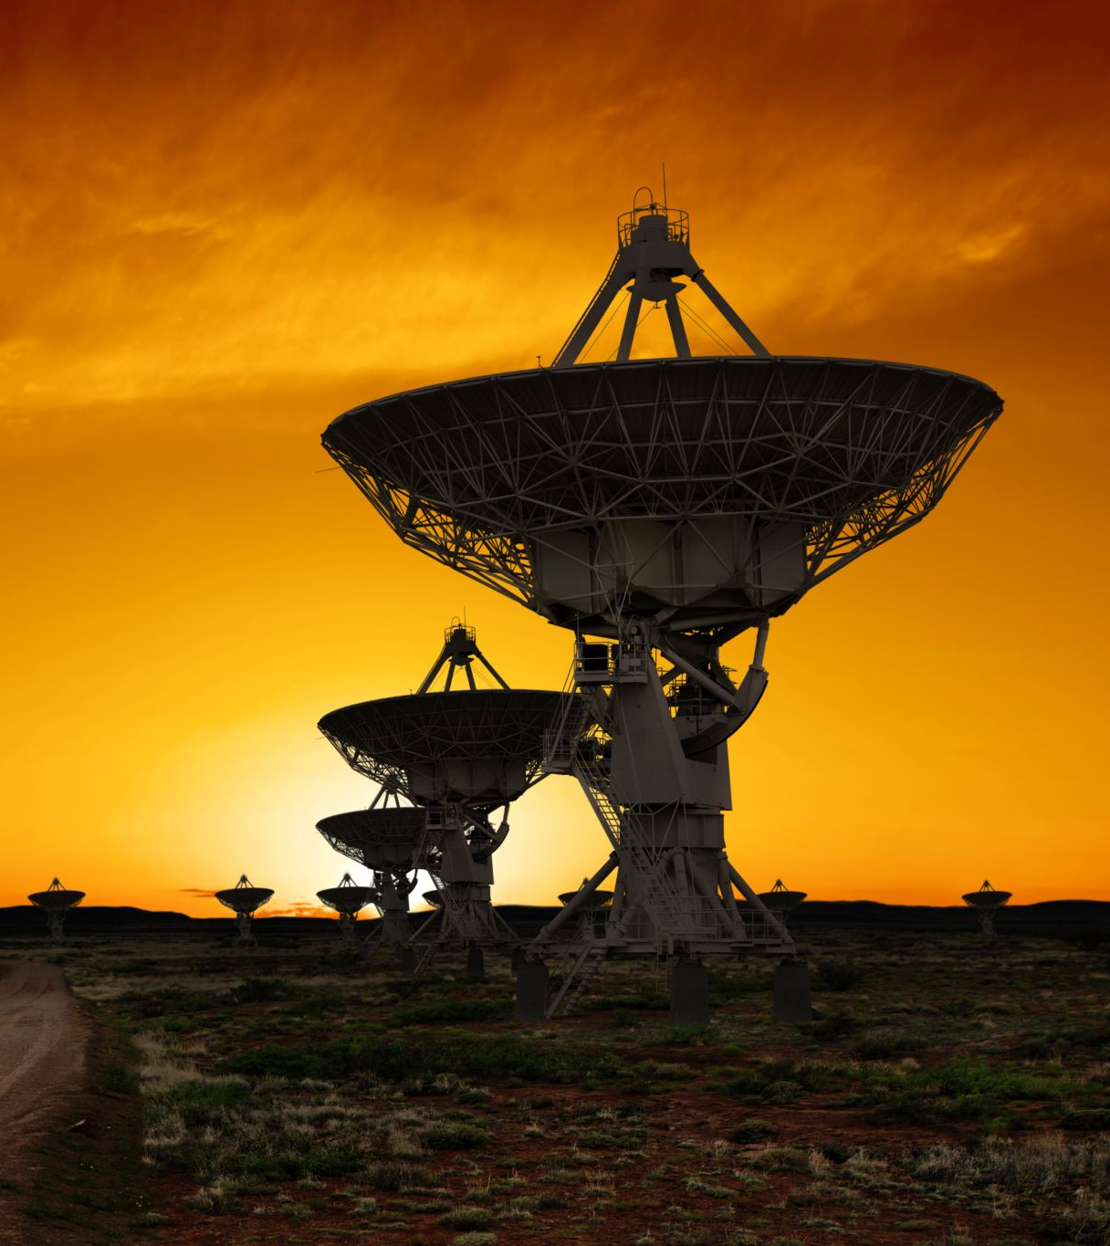
Dataset Overview
We utilized the DRIVE dataset, consisting of retinal fundus images paired with manually annotated vessel masks. The dataset provides a diverse range of images capturing various retinal conditions.

Slide 4

Model Architecture
Our model architecture integrates the EfficientNetB0 backbone with a custom U-Net architecture. This design allows for efficient feature extraction and precise segmentation of retinal vessels.
An attention mechanism is incorporated to enhance the model's focus on relevant image regions, leading to improved segmentation accuracy.

Slide 5

Training Process
During training, the model learns to segment retinal vessels by minimizing the binary cross-entropy loss function.
The training and validation loss were monitored over epochs, as depicted in the visualization below. The model demonstrates consistent improvement in performance over time.

Slide 6
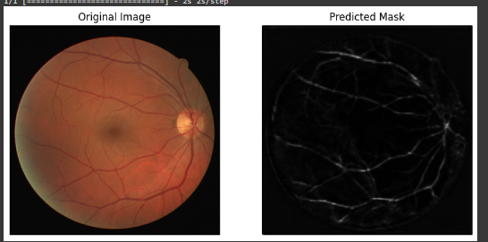
Results - Sample Image
Here, we present a sample retinal fundus image alongside its corresponding true mask and predicted mask. The visualization showcases the effectiveness of our segmentation model in accurately delineating retinal vessels.

Slide 7
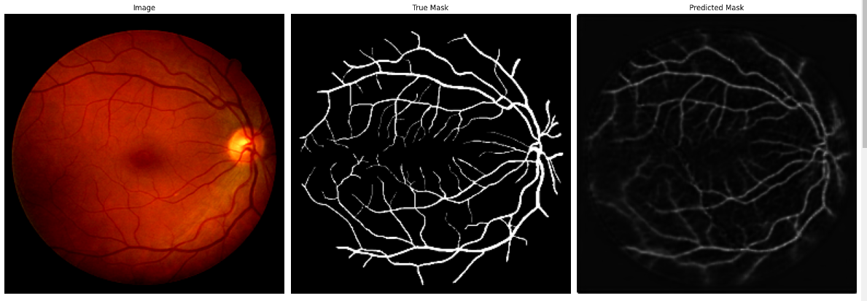
Results - Predicted Masks
Multiple retinal fundus images are displayed alongside their predicted masks. The brightness of the predicted masks has been adjusted for better visualization.
The predicted masks demonstrate the model's ability to accurately segment retinal vessels across different images and conditions.

Slide 8

Conclusion
Our project successfully achieves the objective of developing a segmentation model for retinal fundus images. The model shows promising results in accurately identifying retinal vessels, which can greatly assist in medical diagnosis and treatment planning.

